Slide 1
Exp. 3 Basic Signal Generation and operations
AIM: To generate and manipulate various types of continuous time and discrete time signals in MATLAB
APPARATUS REQUIRED:
HARDWARE : Personal Computer
SOFTWARE : MATLAB
PRE-REQUSITIES: Mathematical representation of various signals like impulse, ramp, unit step, exponential and sinusoidal signals.

Slide 2
IMPORTANCE OF SIGNALS
Signals can be represented in the domain of the original independent variables or in a transformed domain
Likewise, the information extraction process may be carried out in the original domain of the signal or in a transformed domain
DSP is concerned with the mathematical representation of the signal and the algorithmic operation carried out on it

Slide 3
TYPES OF SIGNALS
Depends on the nature of the independent variables and the value of the function defining the signal.
Continuous versus Discrete
Real versus Complex
Scalar versus Vector
One dimensional versus Multi-Dimensional Dimensional
Deterministic versus Random

Slide 4
TYPES OF SIGNALS
The speech signal is an example of a 1-D signal where the independent variable is time
An image signal, such as a photograph, is an example of a 2-D signal where the two independent variables are the 2 spatial variables

Slide 5
TYPES OF SIGNALS
For a 1-D signal, the independent variable is usually labeled as time
In this case, signals can be classified into continuous-time signals and discrete-time signals (sequence of numbers)
A continuous-time signal with a continuous amplitude is usually called an analog signal analog signal
A discrete-time signal with discrete-valued amplitudes represented by a finite number of digits is referred to as the digital signal.
A discrete-time signal with continuous valued amplitudes is called a sampled-data signal
A digital signal is thus a quantized sample data signal

Slide 6
TYPES OF SIGNALS
For a continuous-time 1-D signal, the continuous independent variable is usually denoted by t
For example, u(t) represents a continuous time 1-D signal
For a discrete-time 1-D signal, the discrete independent variable is usually denoted by n.
For example v(n) represents a discrete time 1-D signal
Each member v(n), of discrete time signal is called a sample
In many applications, a discrete time signal is generated by sampling a parent continuous time signal at uniform intervals of time.
If the discrete instants of time at which a discrete-time signal is defined are uniformly spaced, the independent discrete variable n can be normalized to assume integer values

Slide 7
Typical Signal Processing Operations
Most signal processing operations in the case of analog signals are carried out in the time domain
In the case of discrete-time signals time signals, both time domain or frequency-domain operations are usually employed

Slide 8
Signal Processing Operations
Three most basic time-domain signal operations are scaling, delay, and addition
Three other elementary operations are integration, differentiation and product
More complex operations are implemented by combining two or more elementary operations

Slide 9
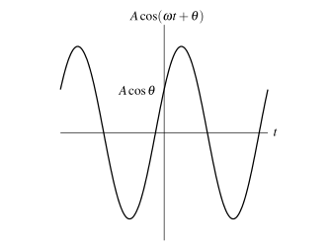
Elementary signals
A number of elementary signals are particularly useful in the study of signals and systems
One important class of signals is the real sinusoids. A real sinusoidal signal x(t) has the general form
x(t) = Acos(ω t + θ ), where A, ω , and θ are real constants
Fig. Real sinusoidal signal

Slide 10
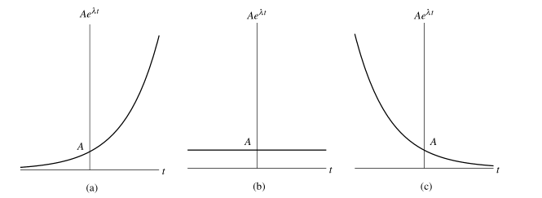
Elementary signals
Another important class of signals is the complex exponentials signals. A complex exponential signal x(t) has the general form
x(t) = Ae^{λt} , where A and λ are complex constants
The second special case of the complex exponential signals that we shall consider is the complex sinusoidal signals.
A = |A|e^{jθ} and λ = j ω , where θ and ω are real constants
Fig. Real exponential signal for a) λ>0, b) λ=0, c) λ<0

Slide 11
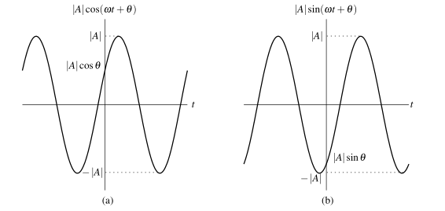
Elementary signals
Examples
Fig. Complex sinusoidal signals a) Real b) Imaginary

Slide 12
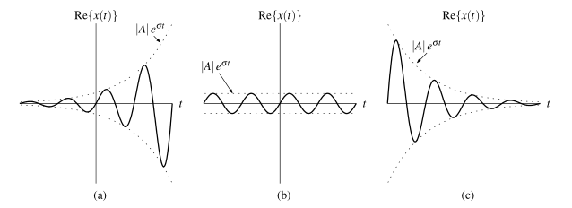
Elementary signals
Lastly, we consider general complex exponential signals. That is, we consider the general case, where A and λ are both complex. For convenience, let us re-express A in polar form and λ in Cartesian form as
A = |A|e^{jθ} and λ = σ + j ω where θ , σ , and ω are real constants
Fig. Real part of general complex exponential signal a) σ>0,
b) σ=0, c) σ<0.

Slide 13
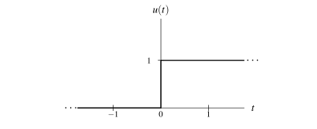
Elementary signals
Another elementary signal often used in systems theory is the unit-step function. The unit-step function, denoted u(t), is defined as
Fig. Unit step function

Slide 14

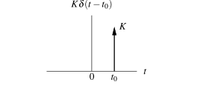
Elementary signals
In systems theory, one elementary signal of fundamental importance is the unit-impulse function. We denote this function as δ (t). Instead of defining this function explicitly, it is defined in terms of its properties. In particular, the unit-impulse function is defined by the following two properties:
Unit impulse function Scaled and shifted unit impulse

Slide 15
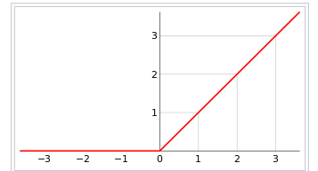
Elementary signals
The ramp function is a unary real function, whose graph is shaped like a ramp. It can be expressed by numerous definitions, for example "0 for negative inputs, output equals input for non-negative inputs". The term "ramp" can also be used for other functions obtained by scaling and shifting, and the function shown is the unit ramp function (slope 1, starting at 0).

Slide 16
OPERATIONS ON SIGNALS
Time reversal maps the input signal x(t) to the output signal y(t) as given by
y(t) = x(−t)
In other words, the output signal y(t) is formed by replacing t with −t in the input signal x(t). Geometrically, the output signal y(t) is a reflection of the input signal x(t) about the (vertical) line t = 0.
Another type of signal transformation is called time scaling. Time scaling maps the input signal x(t) to the output signal y(t) as given by
y(t) = x(at), a is scaling constant

Slide 17
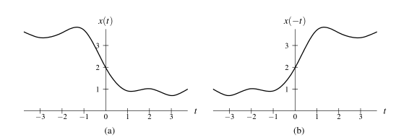
OPERATIONS ON SIGNALS
Fig. Examples of time reversal

Slide 18
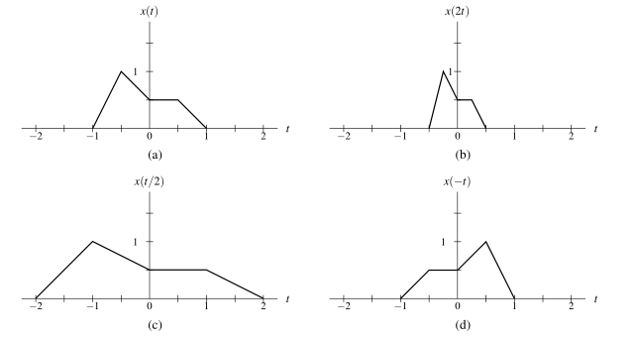
OPERATIONS ON SIGNALS
Fig. Examples of time scaling

Slide 19
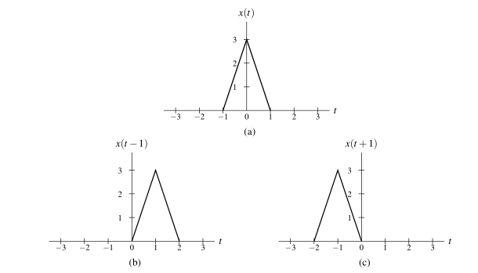
OPERATIONS ON SIGNALS
The next type of signal transformation that we consider is called time shifting. Time shifting maps the input signal x(t) to the output signal y(t) as given by
y(t) = x(t −b), b is shifting constant
Fig. examples of time shifting

Slide 20
Transformations on dependent Variable
The first transformation that we consider is referred to as amplitude scaling. Amplitude scaling maps the input signal x(t) to the output signal y(t) as given by
y(t) = ax(t), a is scaling constant
The next transformation that we consider is referred to as amplitude shifting. Amplitude shifting maps the input signal x(t) to the output signal y(t) as given by
y(t) = x(t)+b, b is a shifting constant

Slide 21
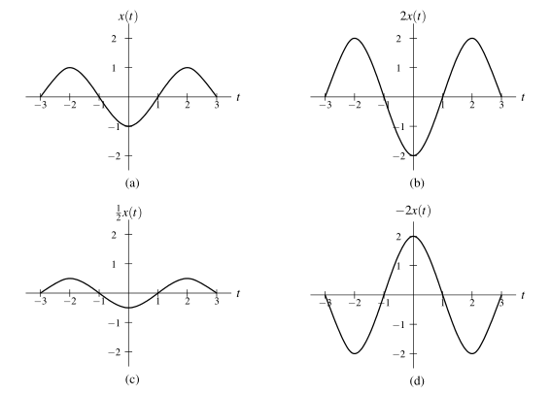
OPERATIONS ON SIGNALS
Fig. Examples of amplitude scaling

Slide 22
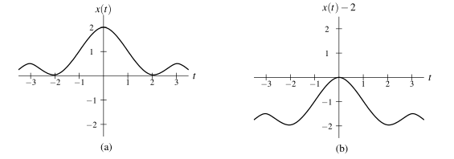
OPERATIONS ON SIGNALS
Fig. Examples of amplitude shifting

